Slide 1
WE AND THE ENVIRONMENT
The why and the what

Slide 2

ECOVENTURE
A Video Tutorial

Slide 3
BEFORE WE BEGIN
The rules to setup the game

Slide 4
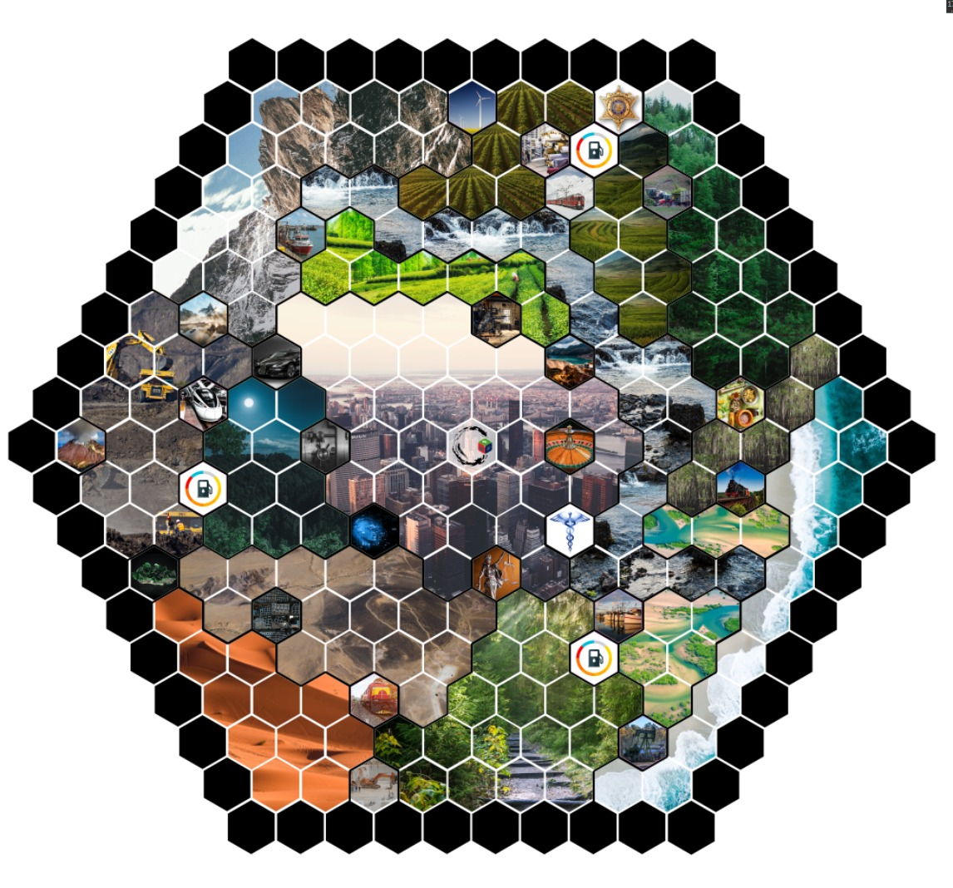






THE ARENA
Notes:
The game begins on the centre of the board called the Arena:
There are 6 slots for each of the 6 players.

Slide 5
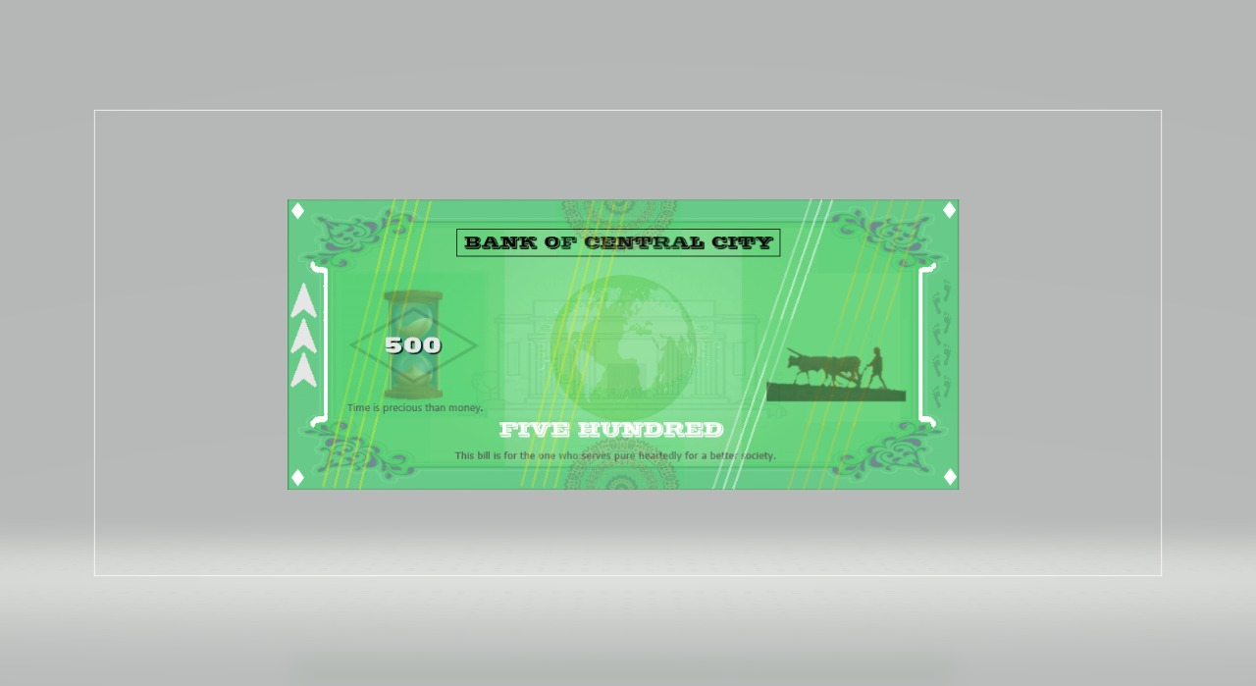

INITIAL CURRENCY
$1,00,000
Notes:
To set the game up each player is given 20,000 in cash Currency and 5 petrol units. What are these used for ?? We will get to know these in the video soon……

Slide 6
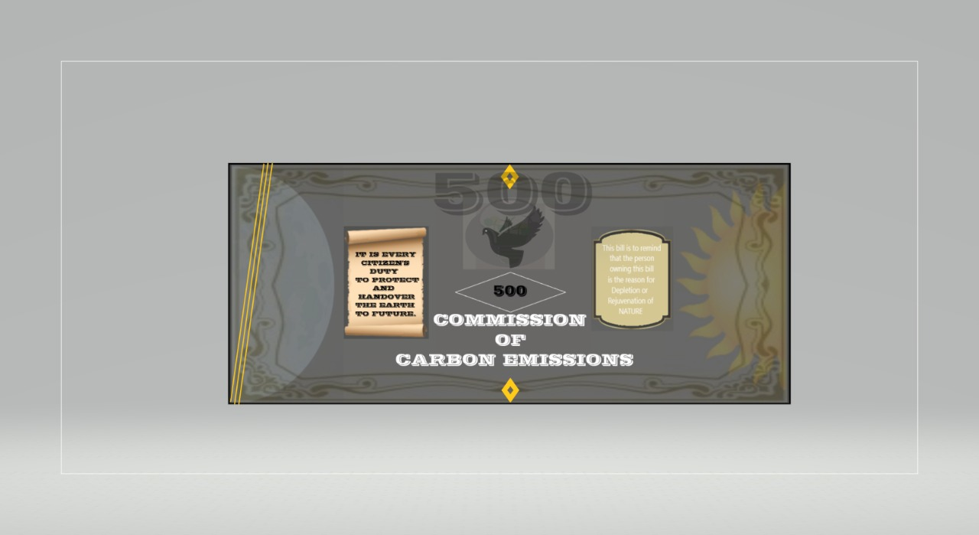
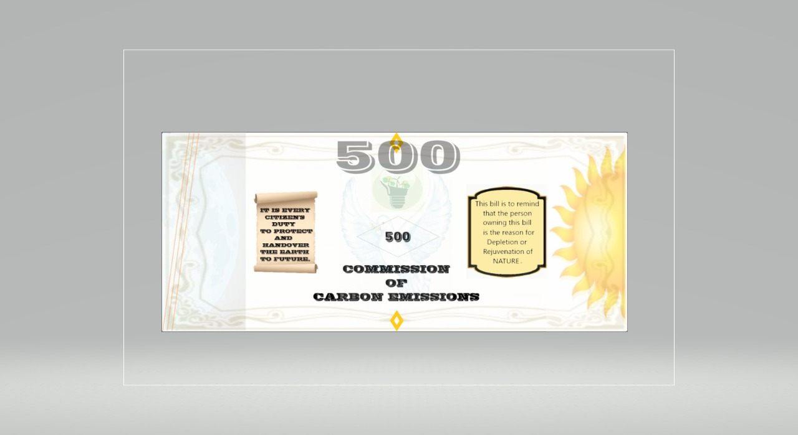
A USEFUL TIP
Notes:
One thing that can be revealed right now, is that your goal should be to maximize this (POINT TO WHITE NOTES), and minimize this (POINT TO BLACK NOTES) throughout the game

Slide 7
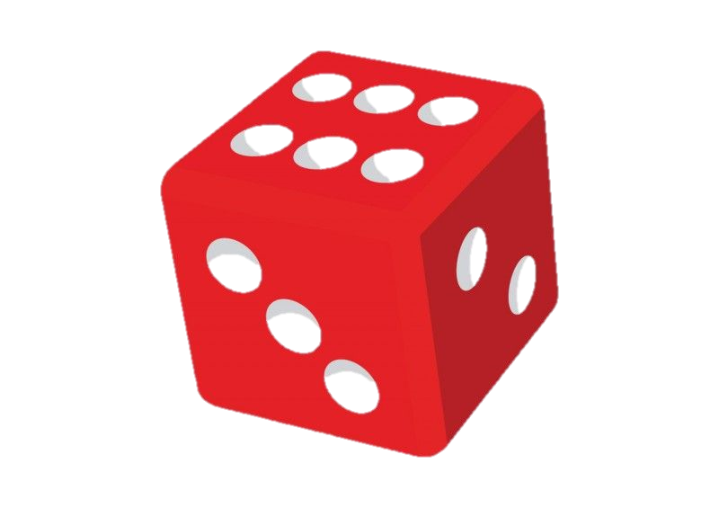
GAMEPLAY
6
6
3
5
1
4
4
3
5
2
2
1
Notes:
Now, how do we line up in the arena: Simple. Each player rolls the dice, and the player with the highest number gets to choose his spot and so on till each player gets his place according to order.

Slide 8

What if two people get the same number?
Roll the dice till one of them gets a bigger number!
Notes:
If there is a tie, then you repeat the same until one person gets the bigger number.

Slide 9

THE OFFICER
Notes:
To keep track of all the spendings and earnings through the game, one person is assigned the role of an officer, preferably someone not playing the game...

Slide 10
TRANSPORT
Make the minutes count!

Slide 11
BASIC
FOUR!!!
FOUR!!!
Notes:
Now that we are set up, let us review how a player can move around on the board.
Every player calls a number from 1 to 6 and rolls a die at the same time. Then the player has to move the number of tiles the die indicates

Slide 12

MOVEMENT

Slide 13
PETROL UNITS
Notes:
Each turn, a player consumes one petrol unit to move on the board. Remember the 5 petrol units you were given at the beginning of the game?? This is where they come in handy. Once you run out of petrol units, you need to refill them, 5 units at a time in one of the three petrol bunks.

Slide 14

THE TREES, THE ENGINE AND THE ROAD
Notes:
And failing to do so would mean you are stuck on the map, or you will have to spend a lot of money to get a towing service to the nearest petrol bunk.

Slide 15
OTHER MODES

Slide 16
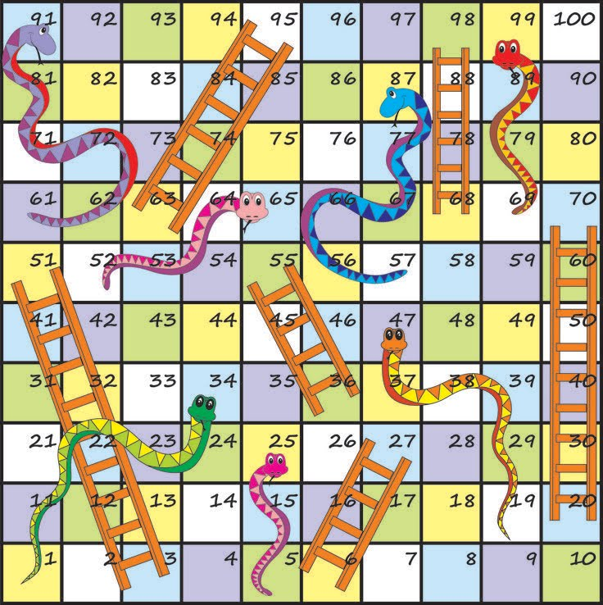

A SIMPLE EXAMPLE
Notes:
If you are still not clear, do you remember the game of Snakes and Ladders?? Well the Railways and Waterways are similar to ladders in those games, in the sense that you can directly move from one end of the board to another.

Slide 17
THE CURRENCY
What makes the mare go!
Notes:
Now let’s talk about what makes the mare go: money. Similar to many business games, we have three types of currency.

Slide 18
PLAIN OLD CASH
Notes:
The first one is the Green currency which is a representation of the money we use everyday. This currency comes in multiple denominations like *insert*. At the beginning of the game, every player will be given an exact amount of 20,000 green notes.

Slide 19

CARBON CURRENCY
The price you pay to nature
Notes:
In recent times, people have started looking at carbon emissions as a measurement of productivity. This led to the concept of carbon currency, which we have incorporated in this game.

Slide 20
THE BLACK CURRENCY
Notes:
This is the ‘black’ carbon currency which tells an estimation of how your industrial activities are affecting the environment.

Slide 21
THE WHITE CURRENCY
Notes:
And then we have the ‘white’ carbon currency which reduces the black currency you have. These notes are available only when you have ZERO black currency and ultimately decides the winner of the game.

Slide 22
A DEMO
Notes:
Suppose you are buying an industry in the mines region as shown here. You already have a cash reserve. On purchase, your cash reserves deplete and you get some amount of black currency in return.

Slide 23
THE INDUSTRIES
Let’s stick to the fundamentals
Notes:
We’ll move onto Industries. In this game, there are two types of industries: the existing ones and the new ones. Let’s see them in more detail.

Slide 24
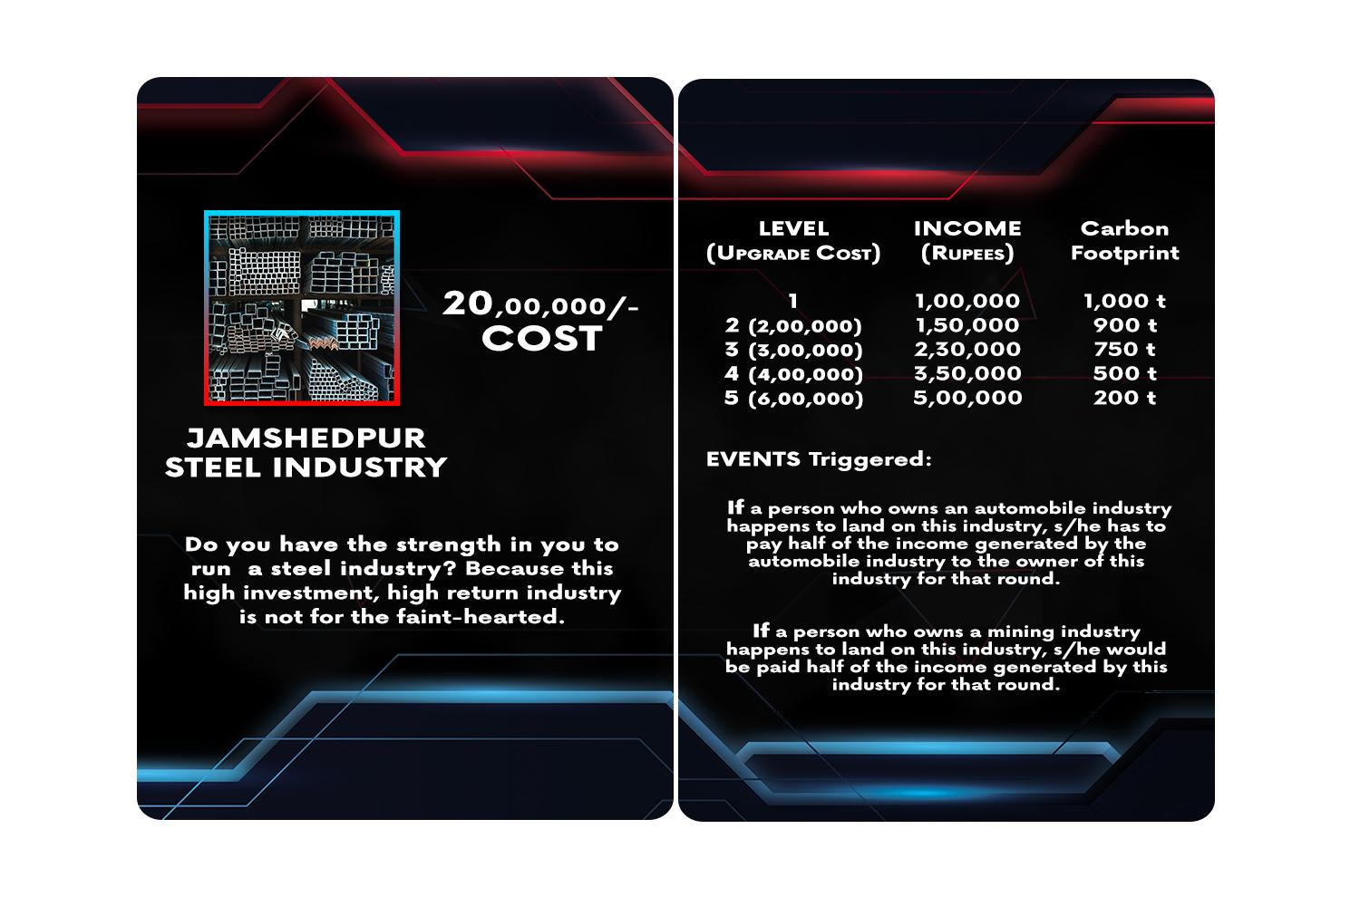
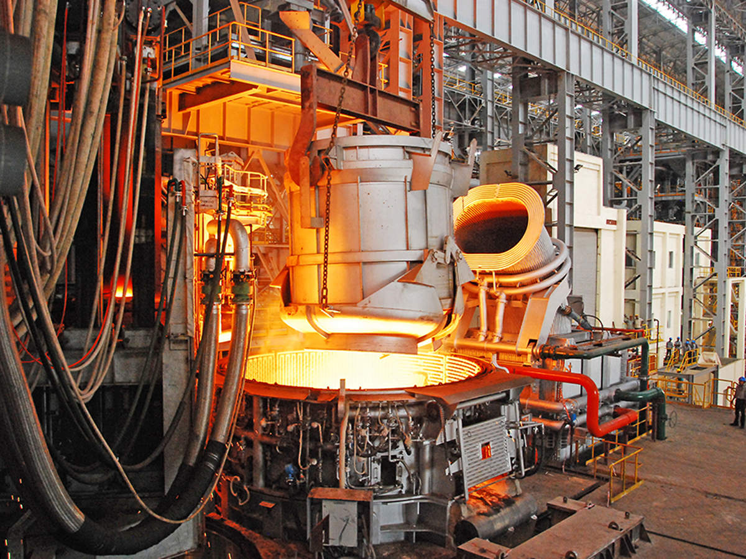
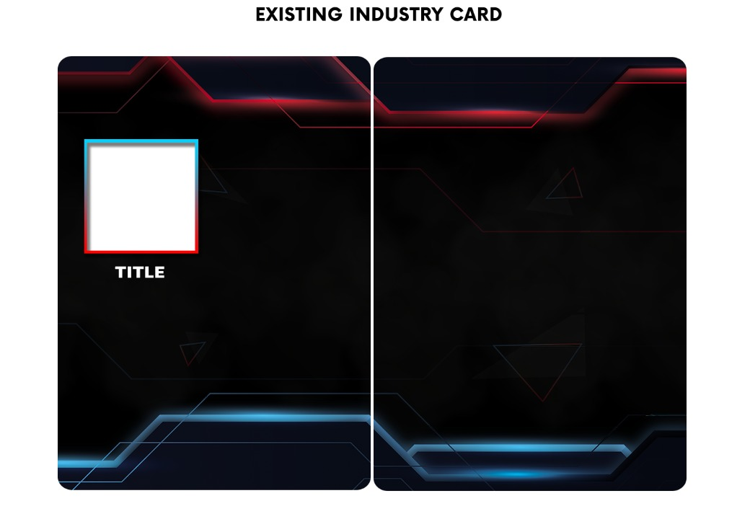
EXISTING INDUSTRIES
Notes:
These industries are already established. They offer the advantage of having the capacity of mass production as soon as they are bought.

Slide 25
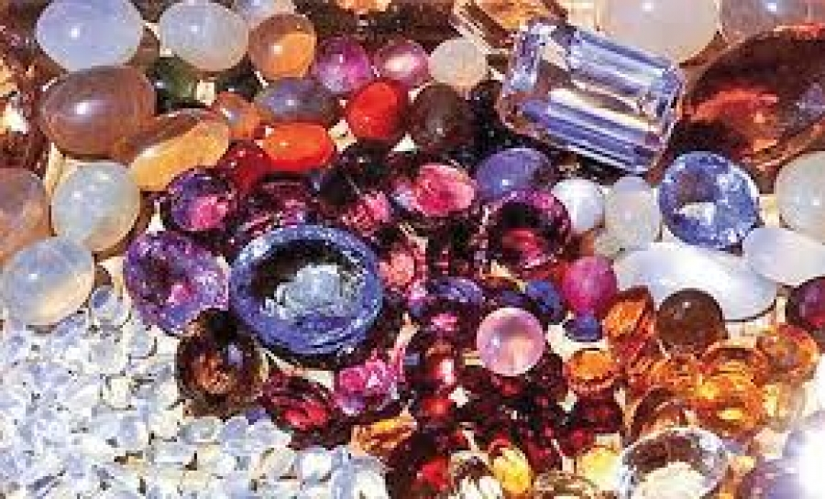
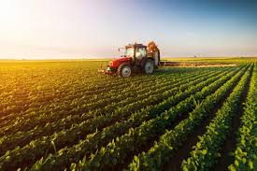
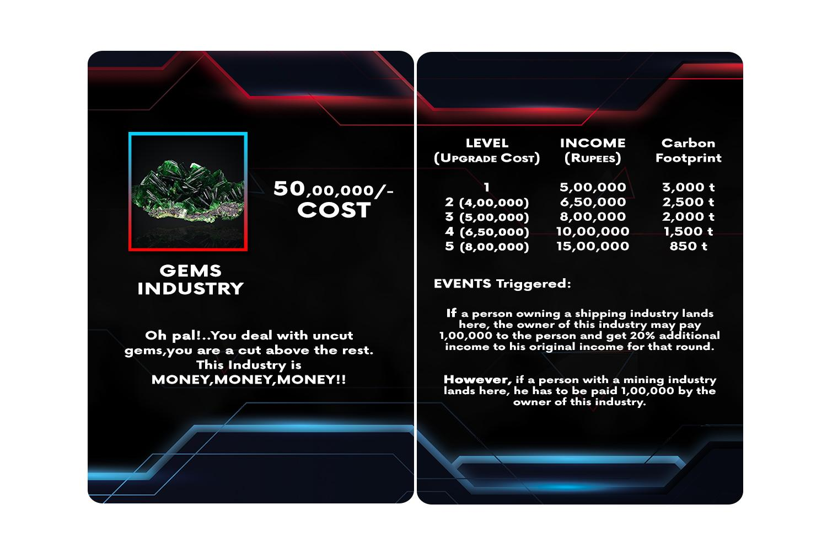
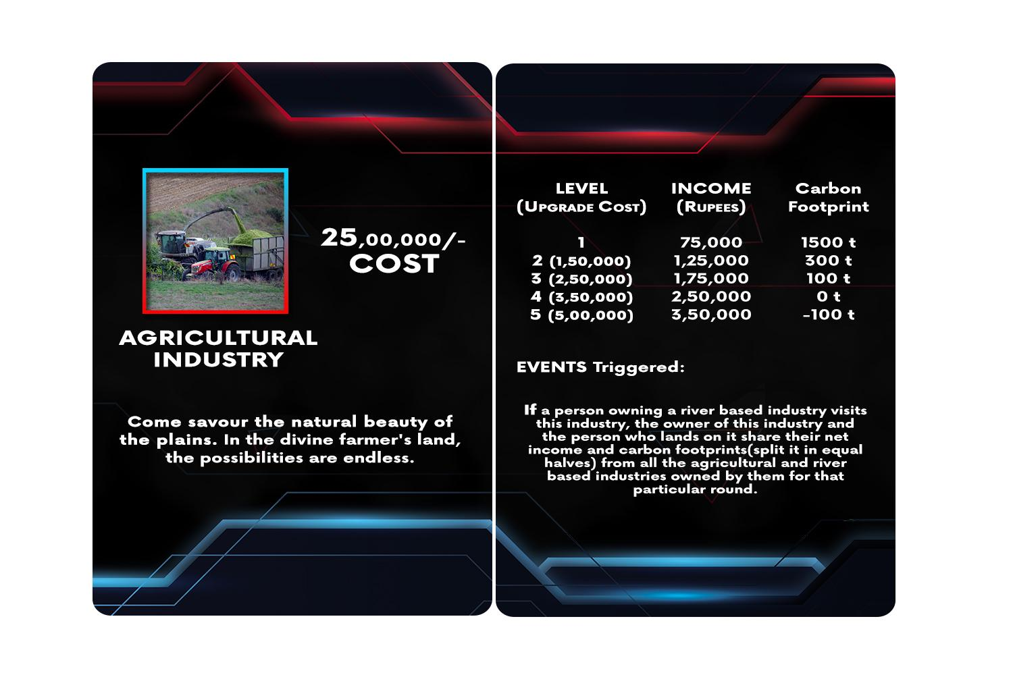

Slide 26
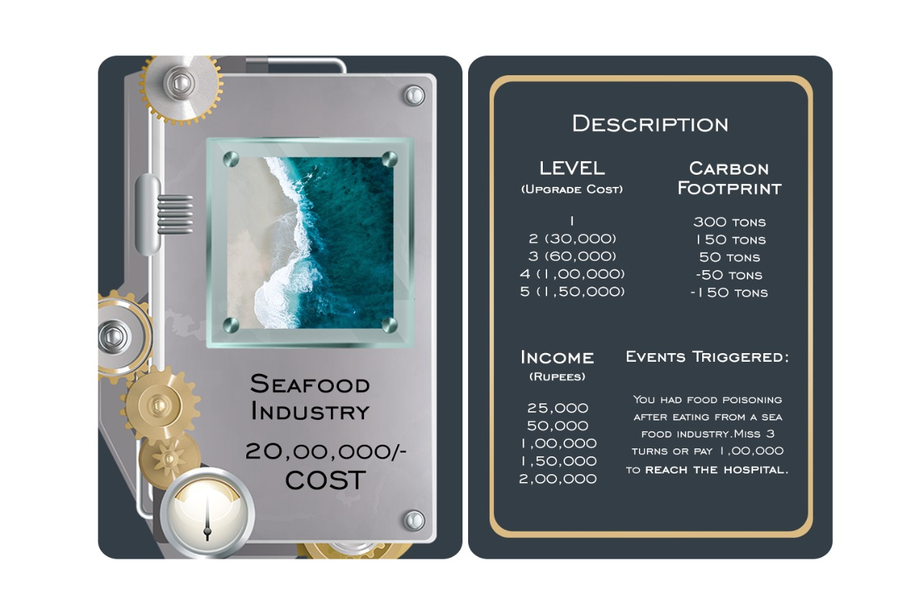
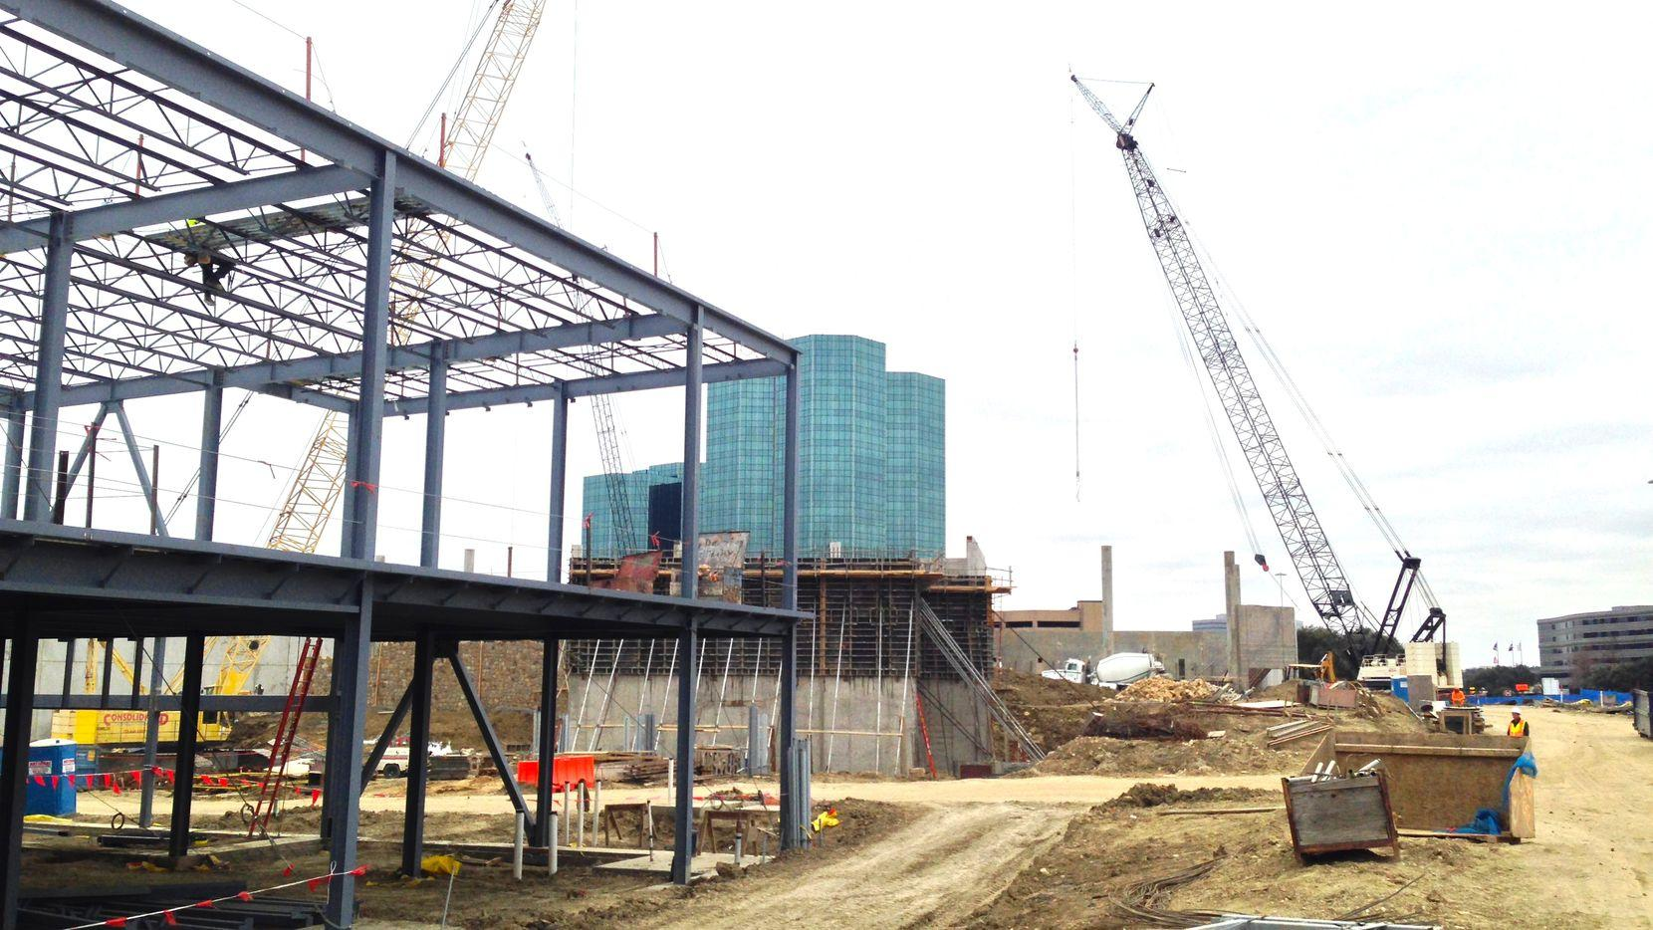
NEW INDUSTRIES
Notes:
The other option is to build new industries. The clean slate!
We have restricted the number of new industries one can develop to minimize the impact on the environment.

Slide 27
GOVERNMENT GUIDELINES
As approved by the ISO!!!
Notes:
Variety is the spice of life they said. The same holds good for our board game too. You become a business tycoon by travelling all around the world…. But, what is the point of it if you dont enjoy your successes with some chance and fun events along the way?? This is why we have random events across the game, triggered at specific situations:

Slide 28
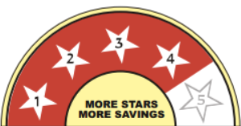
BASED ON EFFICIENCY
Star rating | Black Currency/round | Income/round | Upgrade cost
1 | 100 | 1000 | 10000
2 | 50 | 2000 | 20000
3 | 20 | 3000 | 30000
4 | 10 | 5000 | 50000
5 | 5 | 10000 | -
An example table

Slide 29
AUTOMOBILE GRADES
Label | Rating | Black currency | Fuel cost/round | Upgrade cost
BS1 | One star | 100 | 2000 | 1,00,000
BS2 | Two star | 80 | 1500 | 2,00,000
BS3 | Three star | 60 | 1000 | 5,00,000
BS4 | Four star | 30 | 500 | 10,00,000
BS6 | Five star | 0 | 0 | -
Notes:
But, this is where it gets interesting. How do you think you refuel your cars in real life?? Certainly petrol does not come for free. Either your Dad, Mom, Brother or your Sister or you yourself may be paying the petrol price. Here in the game, you start off with a basic Level 1 automobile which costs you this much CF(100) and this much of cash (2000) to travel one round. As you play the game, you can upgrade the automobile to five different levels:
The best part: The level 5 automobile in the game lets you ride around the board for free!!! So, try upgrading your ride.

Slide 30
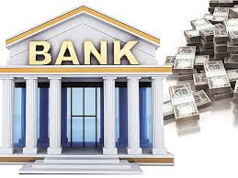
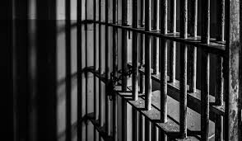
THE JAIL AND THE CENTRAL BANK

Slide 31
THE EVENT CARDS
For the spice of life!
Notes:
Variety is the spice of life they said. The same holds good for our board game too. You become a business tycoon by travelling all around the world…. But, what is the point of it if you dont enjoy your successes with some chance and fun events along the way?? This is why we have random events across the game, triggered at specific situations:

Slide 32
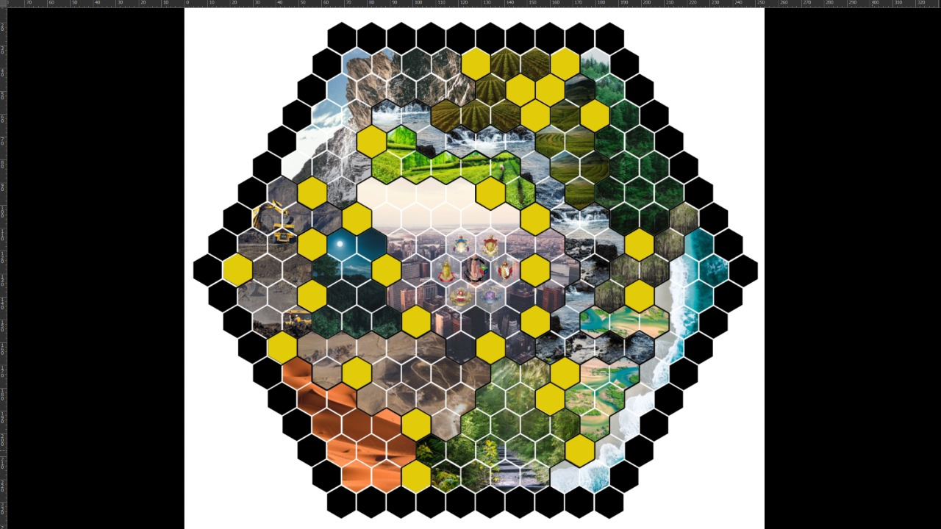
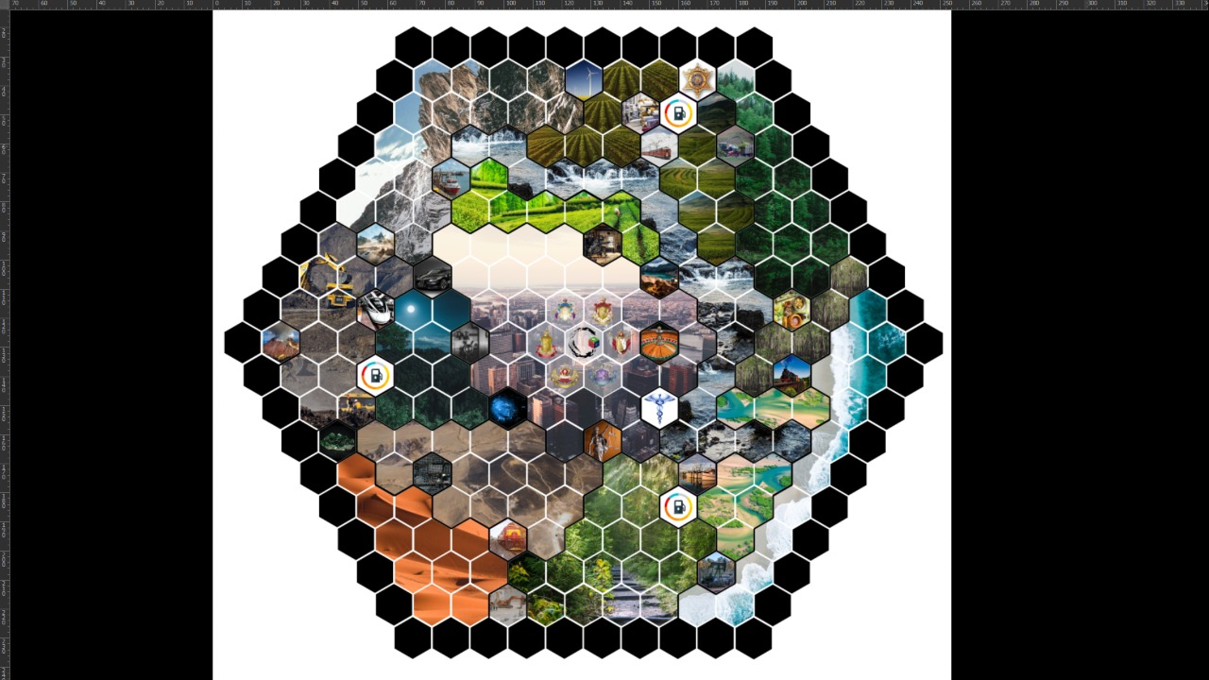
EVENT REGIONS
Notes:
First way is by landing on event regions on the board (HIGHLIGHT ON BOARD WITH ANIMATION). You land on the region and you will be directed to complete a particular task.

Slide 33
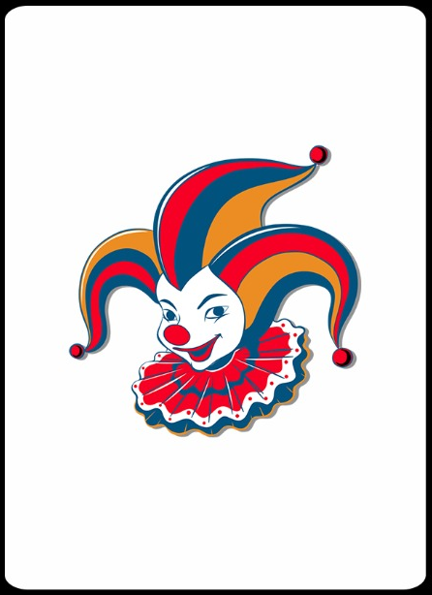
WHEN LUCK MATTERS
Notes:
Second way is more dependent on your luck. Remember at the start of the tutorial you were asked to tell a random number before you rolled the dice?? Well if you guess the number of the die correctly, it means you get to choose a random event card just to spice the games up.

Slide 34
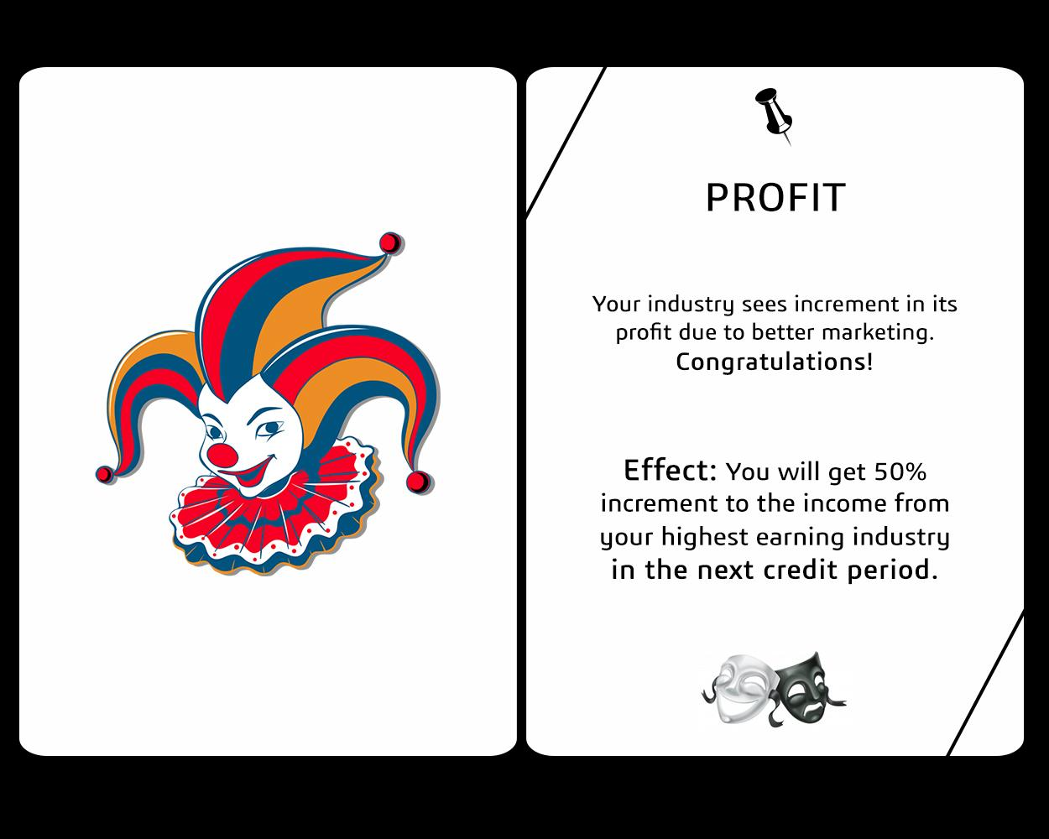
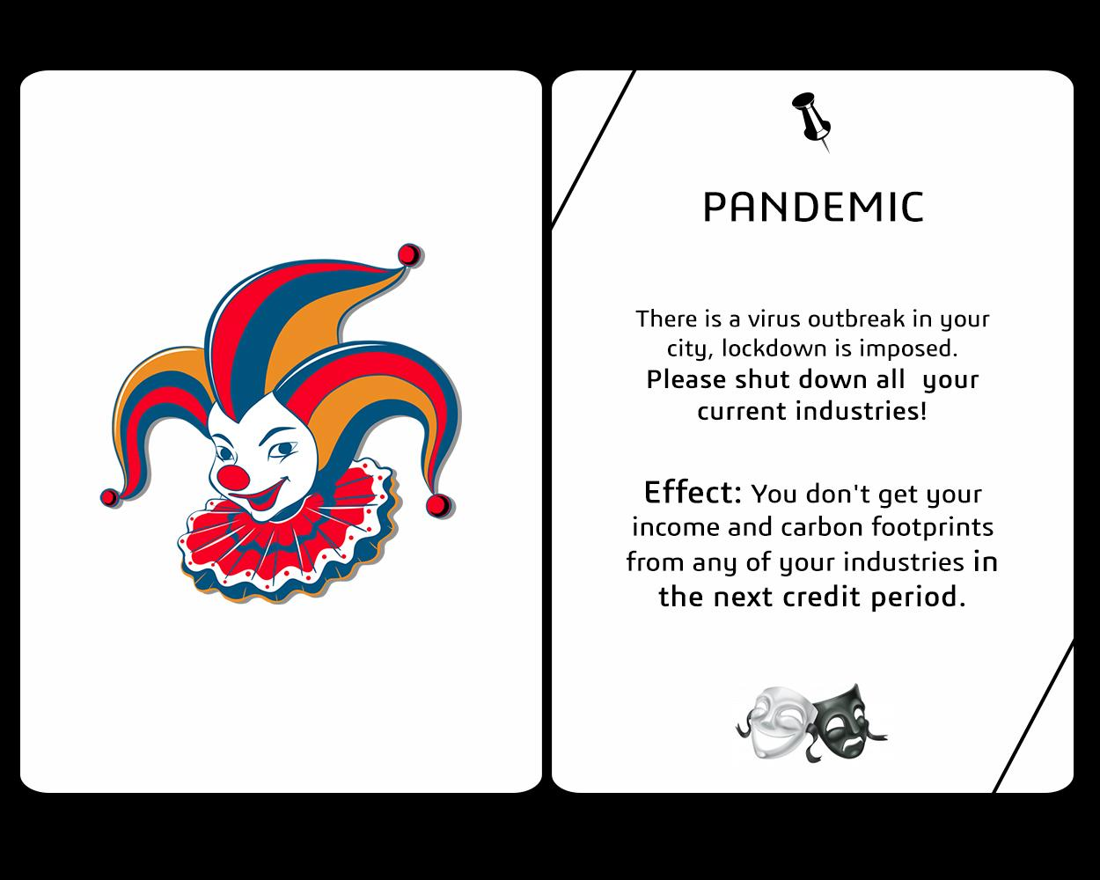
A TALE OF TWO CARDS
Notes:
You may receive bonuses, maybe get stuck in a pandemic or maybe even get stuck in traffic for all that you know.

Slide 35
THE ENDGAME
Aw, Snap!

Slide 36


THE ELITE CLUB
Notes:
As the game progresses, the top half of the players make up the ‘Elite Club’. The members of the elite club must satisfy the following criteria:
White Currency > Black Currency
Must have a Level 5 industry
Must have a minimum bank balance of *insert amount*

Slide 37

THE TOP HALF OF
Notes:
The game ends when at least half the players enter the elite club. Now, the black notes will be eliminated by an equal amount of white notes. The player with the maximum number of white notes is declared the winner.

Slide 38
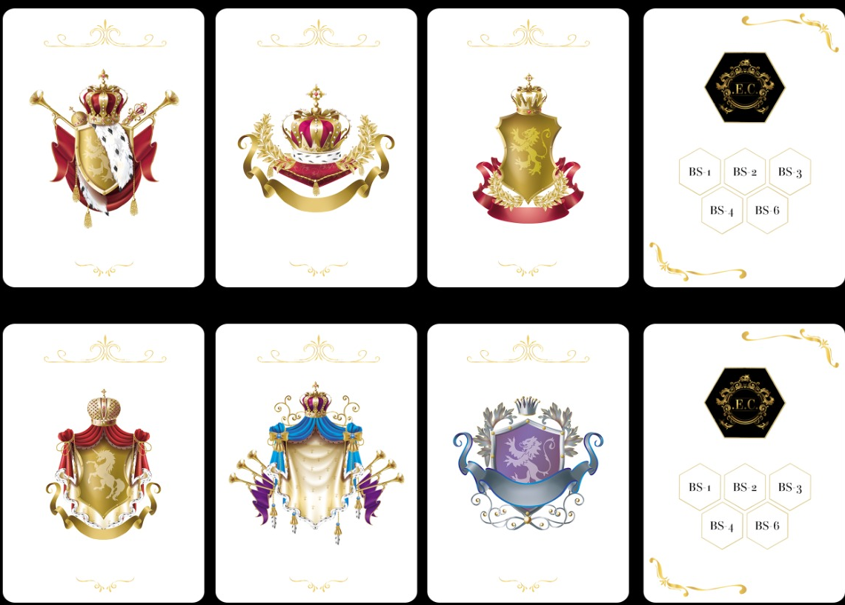
How do we keep track of who is in the Elite Club??
CUSTOM CARDS FOR EACH PLAYER!!!!
Notes:
No, sometimes it may happen that even though 4 people have built elite industries, none of them may have a net positive carbon footprint. In that case no one is a winner.
AAAH . BUT THIS IS PAINFUL. WHY DID WE PLAY??
Simple. So you think Earth will give you second chances in case no one takes care of the environment from the start? No. That is why we do not have second chances in the game. The industry rule was to make you an entrepreneur. And, the carbon footprint rule was to make you a green entrepreneur. Hope you all become green tycoons!!!!

Slide 39
THANK YOU FOR WATCHING FROM THE TEAM!!!!
R&D TEAM: Prabhat Reddy
Madhavan Nampoothri
Sibibalan Jeevanandam
Abhishek Tak
Velturi Harshavardhan
DESIGN TEAM: Yashas S V
Vattem Abhilash
CONTENT DEV TEAM: Umaeshwer Shankar
Rahul Choudhary
Adithya T Deepak
Sudarshan H V

Slide 40


